Slide 1
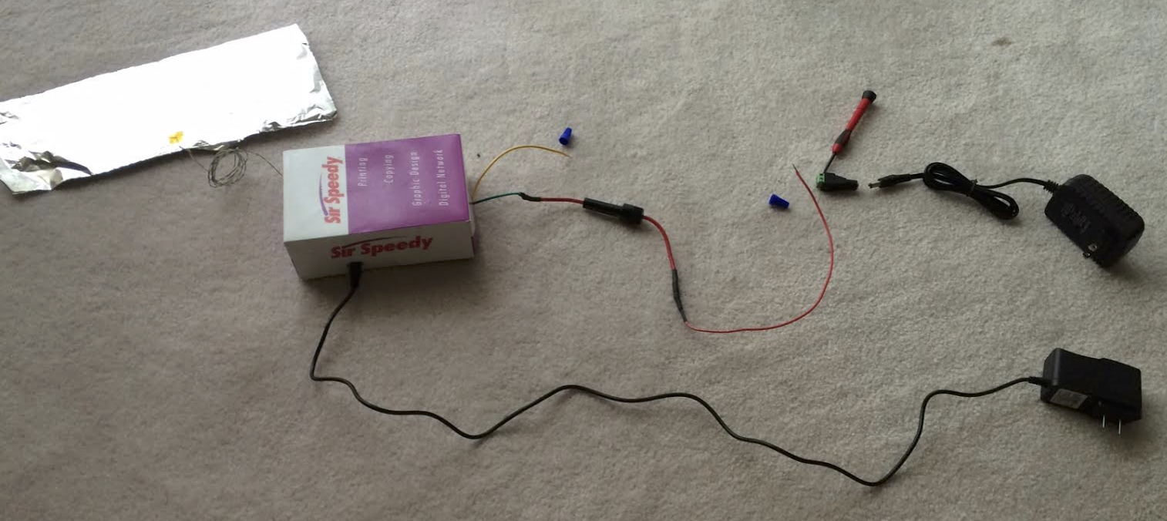
F
B1
C
G
E
B2
A
H
D
A. Connector for 12VDC Power adapter, 2A
B. Blue Wire Connector
C. Phillips head screwdriver (will not be provided)
D. 12VDC Power adapter, 1A – for Arduino
E. 12VDC Power adapter, 2A – for magnetic lock
F. Foil for Buddha
G. Yellow wire
H. Red wire
Magnetic lock is not pictured

